Slide 1
Continuous Progress Presentation
School of Engineering and IT
Three Phase Power Flow Method Using Sequence Components
Presenter: Krishneel Prakash
Supervisor: Prof. Hemanshu Pota
Co-Supervisor: Dr. F R Islam

Slide 2
Purpose of Power Flow Analysis
A load flow analysis is done on power systems to ensure that:
Generation supplies the demand (load) plus losses
Bus voltage limits are within the rated values
Generation operates within specified real and reactive power limits
Transmission lines and transformers are not overloaded

Slide 3
Three Phase Power Flow Problem - Sequence Component Frame
Sequence Component Frame: Three phase unbalanced systems - represented as three separate balanced vector systems with 120 degrees phase relationships
Advantage: Reduces the size of the problem e.g. In Newton Raphson Method, the size of problem is reduced from (6N x 6N) Jacobean Matrix to a single (2N x 2N) for positive sequence and two (N x N) matrix for negative and zero sequence nodal voltage equations.
Pandapower developers have used sequence component frame model to develop the three phase unbalanced power flow algorithm referring to the work done in [1].

Slide 4
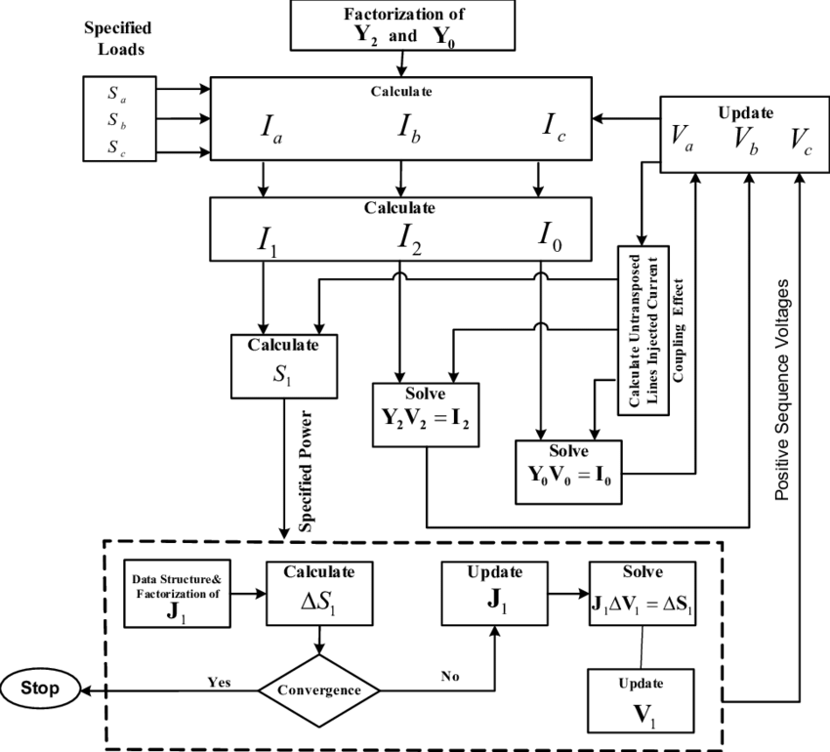
Power Flow Algorithm

Slide 5
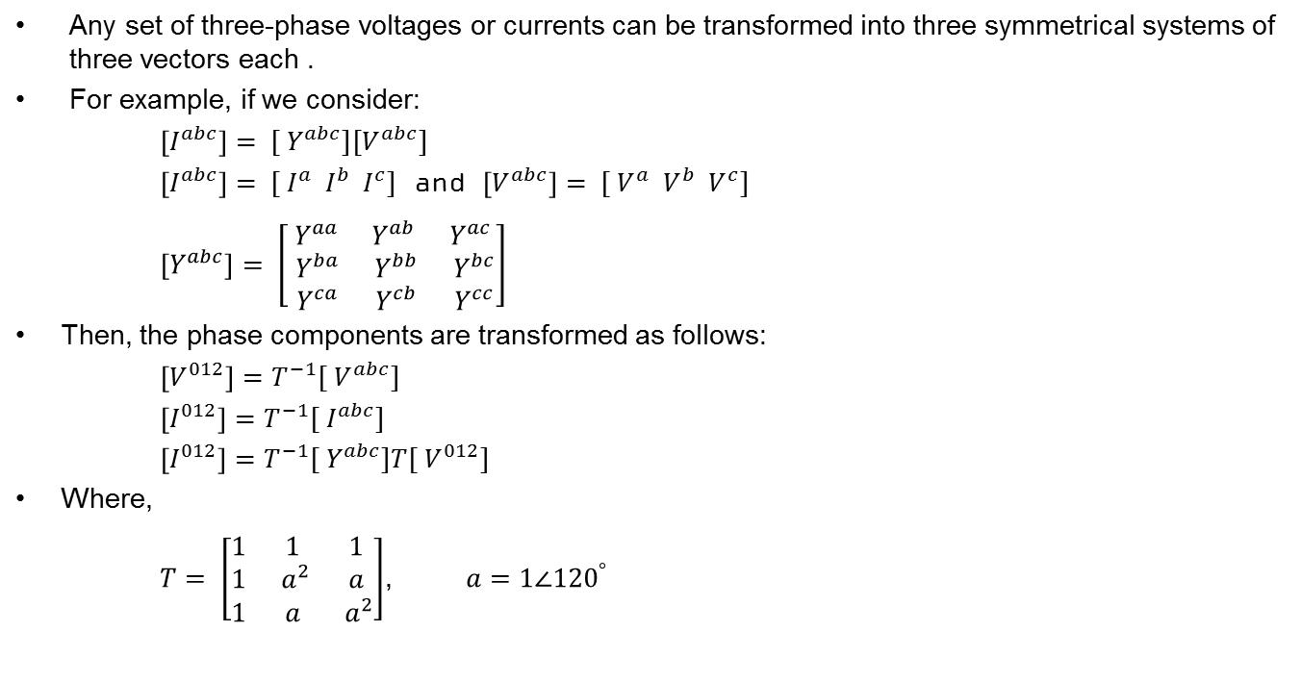
Symmetrical Component Transformation:
Any set of three-phase voltages or currents can be transformed into three symmetrical systems of three vectors each .
For example, if we consider:
$\left[I^{abc}\right]= {[ Y}^{abc}][V^{abc}]$
$\left[I^{abc}\right]= {[ I}^{a} I^{b} I^{c}]$ and $\left[V^{abc}\right]= {[ V}^{a} V^{b} V^{c}]$
$\left[Y^{abc}\right]= \left[\begin{matrix}{ Y}^{aa} & Y^{ab} & Y^{ac} \\ { Y}^{ba} & { Y}^{bb} & { Y}^{bc} \\ { Y}^{ca} & { Y}^{cb} & { Y}^{cc}\end{matrix}\right]$
Then, the phase components are transformed as follows:
$\left[V^{012}\right]=T^{−1}{[ V}^{abc}]$
$\left[I^{012}\right]=T^{−1}{[ I}^{abc}]$
$\left[I^{012}\right]=T^{−1}{[ Y}^{abc}]T{[ V}^{012}]$
Where,
$T= \left[\begin{matrix}1 & 1 & 1 \\ 1 & { a}^{2} & a \\ 1 & a & { a}^{2}\end{matrix}\right]$, $a=1∠{120}^{°}$

Slide 6
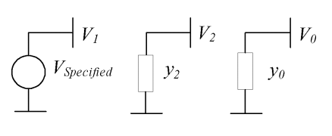
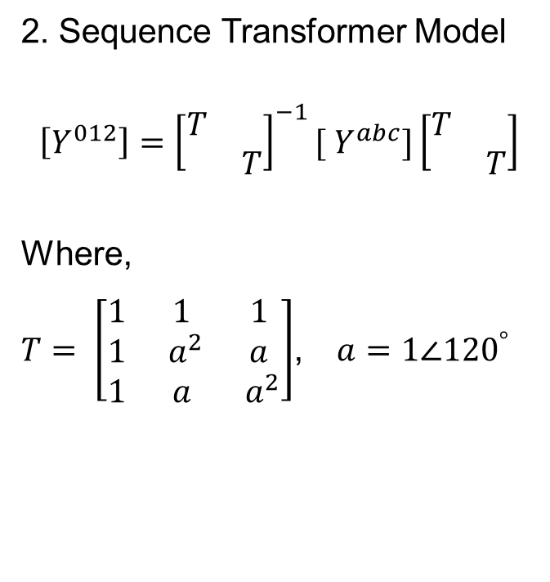
Modelling of Three Phase Power System Components
Sequence Generator Model
2. Sequence Transformer Model
$$\left[Y^{012}\right]={\left[\begin{matrix}T & \\ & T\end{matrix}\right]}^{−1}{[ Y}^{abc}]\left[\begin{matrix}T & \\ & T\end{matrix}\right]$$
Where,
$T= \left[\begin{matrix}1 & 1 & 1 \\ 1 & { a}^{2} & a \\ 1 & a & { a}^{2}\end{matrix}\right]$, $a=1∠{120}^{°}$

Slide 7
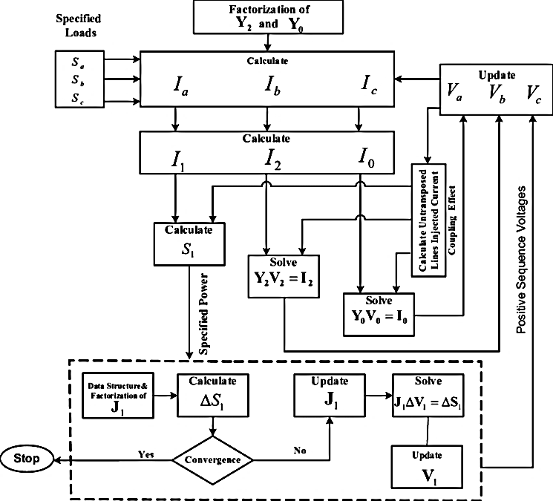
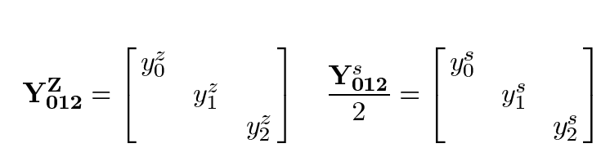
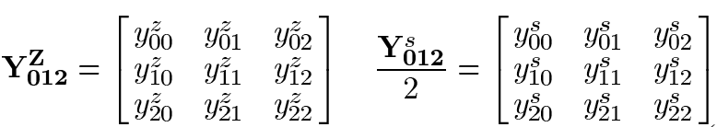
Continued..
3. Sequence Transmission Line Model
For balanced or transposed Lines:
For Unbalanced or un-Transposed Lines:

Slide 8
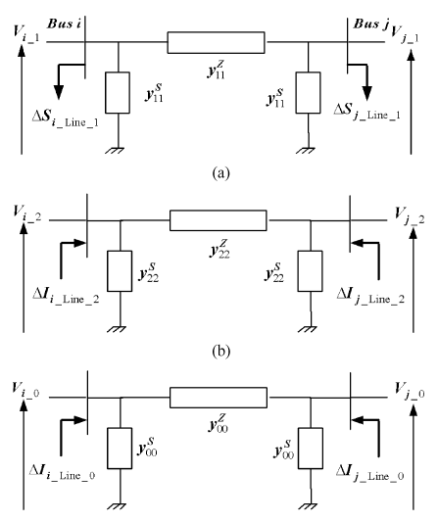
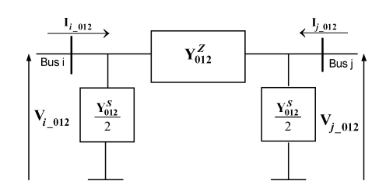
Continued..
Problem: The sequence coupled line model is characterized by weak mutual coupling
Solution: Decouple it into three independent sequence circuits
How??
Eliminate the off diagonal elements of the impedance matrix by replacing them with certain compensation current injection

Slide 9
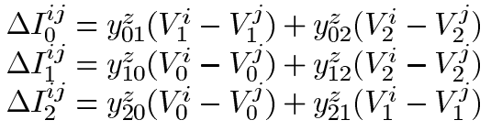
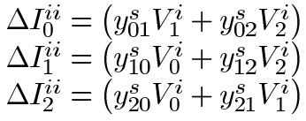

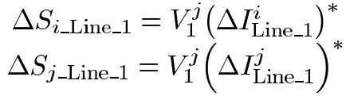
Continued..
Off diagonal current for series admittance matrix:
For shunt admittance matrix:
So the final sequence current at the line bus is:
At Bus i:
At Bus j:
Positive Sequence Power Injection:

Slide 10



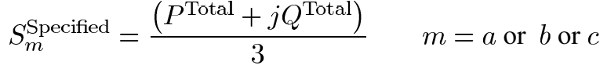
Sequence Power Flow Method
A. Bus Specification:
Slack Bus – both positive sequence voltage magnitude and angle are specified
PV Bus (voltage controlled bus) – both positive sequence voltage magnitude and total power are specified.
Load Bus
For balanced loads:
For unbalanced loads:

Slide 11
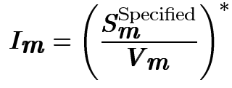
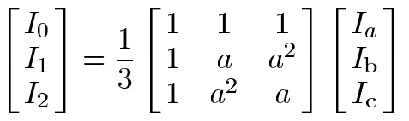



Continued..
Injected current on each phase:
Injected current for the sequence network:
For the traditional power flow studies, the current in positive sequence is modified to the power injection (actual load)

Slide 12
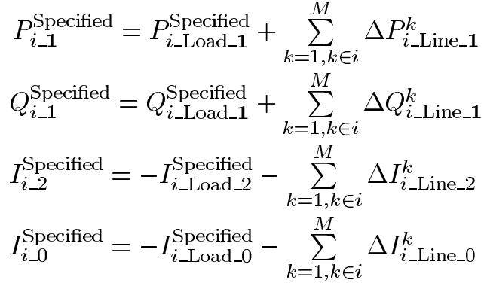
Continued..
Total final sequence specifications at bus i:

Slide 13

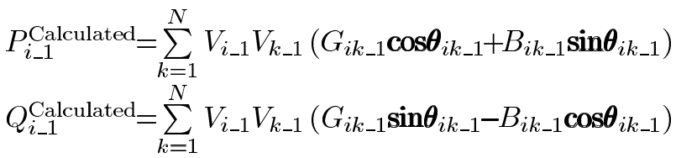

Continued..
B. Positive Sequence Power Flow and Nodal Voltages
To determine the convergence, positive sequence mismatch is considered:
Where,
Positive sequence nodal voltages - using the Newton Raphson Method

Slide 14


Continued..
C. Negative and Zero Sequence Nodal Voltages:
The nodal voltages at negative and zero sequence are found using the following equations:

Slide 15
Reference
[1] M Abdel-Akher, K M Nor, A A Rashid. Improved three-phase power flow methods using sequence components. IEEE Transactions on power systems. 2005. Volume 20. pp. 1389-97
[2] K. L. Lo and C. Zhang. Decomposed three phase power flow solution using the sequence component frame. IET Proceedings – Generation, Transmission and Distribution. 1993. Volume 140. pp. 181–188.
[3] X. P. Zhang. Fast three phase load flow methods. IEEE Transaction on Power System. 1996. Volume 11. pp. 1547–1553.
[4] B. C. Smith and J. Arrillaga. Improved three-phase load flow using
Phase and sequence components. IET Proceedings – Generation, Transmission and Distribution. 1998. Volume 145. pp. 245–250
[5] X. P. Zhang and H. Chen. Asymmetrical three phase load flow based
on symmetrical component theory. IET Proceedings – Generation, Transmission and Distribution. 1994. Volume 137. pp. 248–252.

Slide 16


